Slide 1
Eliminating Health Disparities: The Promise of Health Naming & Moving Research & Action
November 15, 2011
Presented by: Lisa Cacari Stone, PhD
Community Engagement Core
Shiprock, NM

Slide 2
Health Disparities in New Mexico
Hispanics had the worst rates on 4 indicators (teen births, chlamydia, adults 65+ not receiving a pneumonia vaccination, drug induced deaths).
American Indians fared the worst on 7 indicators (prenatal care, diabetes deaths, overweight among youth, pneumonia & influenza deaths, motor vehicle deaths, youth suicide, alcohol related deaths).
African-Americans fared the worst on 4 indicators (infant mortality, adult obesity, HIV/AIDS, homicide).
Whites had the highest rates on 3 indicators (suicide, individuals with diabetes not receiving preventive services, pertussis).
Asian/Pacific Islanders had the highest rate on 2 indicators (hepatitis B and smoking).

Slide 3
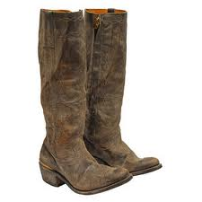
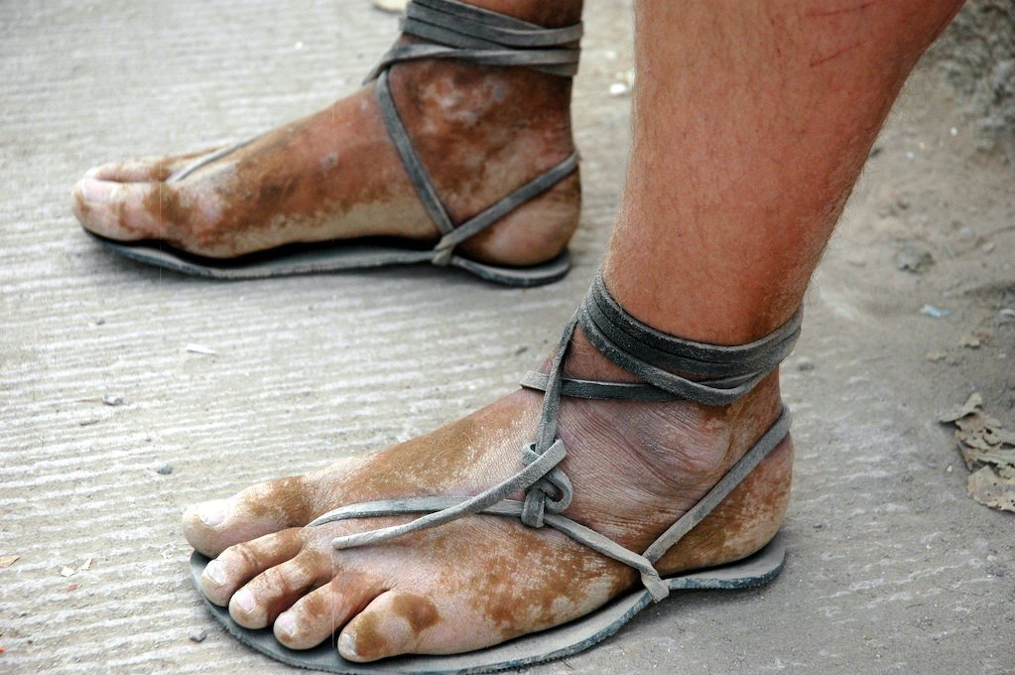
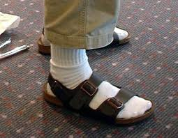
“A Pair of Shoes” for the Journey
Notes:
"How we define and frame the problem of disparities is key to how we approach the solutions. If we merely define health disparities as difference, or unequal then one intervention would be to give all folks a pair of shoes to help level the playing field. If we frame it in terms of unjust differences in resources or inequities, then we would provide folks with a pair of shoes that actually fit them. Different meanings lead to different roads- if we chose the road less traveled, that is to journey towards health and social equity, then we all need a good pair of shoes that fit to walk down that road together. "
Chanclas, boots, moccasins

Slide 4
Health Disparity
“…differences that occur by gender, race, ethnicity, education or income, disability, living in rural localities or sexual orientation.”
Healthy People 2010, USDHHS
“…differences in the incidence, prevalence, mortality, and burden of diseases and other adverse health conditions that exist among specific population groups in the U.S. Research on health disparities related to socioeconomic status is also encompassed in this definition.”
National Institutes of Health (2000)
Carter-Pokras, O. & Baquet, C. What is a "health disparity"?
Public Health Rep. 2002 Sep-Oct; 117(5): 426–434.
Notes:
What is a "health disparity"?
The first attempt at an official definition for "health disparities" was developed in September 1999, in response to a White House initiative. The National Institutes of Health (NIH), under the direction of then-director Dr. Harold Varmus, convened an NIH-wide working group, charged with developing a strategic plan for reducing health disparities. That group developed the first NIH definition of "health disparities":
“Health disparities are differences in the incidence, prevalence, mortality, and burden of diseases and other adverse health conditions that exist among specific population groups in the United States.”
In 2000, United States Public Law 106-525, also known as the "Minority Health and Health Disparities Research and Education Act," which authorized the National Center for Minority Health and Health Disparities, provided a legal definition of health disparities:
“A population is a health disparity population if there is a significant disparity in the overall rate of disease incidence, prevalence, morbidity, mortality or survival rates in the population as compared to the health status of the general population.” Minority Health and Health Disparities Research and Education Act United States Public Law 106-525 (2000), p. 2498
Since the passage of U.S. Public Law 106-525, many agencies have incorporated this definition into their own materials, such as this excerpt from the U.S. Department of Health and Human Services' Office of Minority Health website:
“Different public and private agencies may have different definitions of a 'health disparity' for their own program-related purposes, but these definitions tend to have several things in common. In general, health disparities are defined as significant differences between one population and another. The Minority Health and Health Disparities Research and Education Act of 2000, which authorizes several HHS programs, describes these disparities as differences in "the overall rate of disease incidence, prevalence, morbidity, mortality or survival rates." There are several factors that contribute to health disparities. Many different populations are affected by disparities including racial and ethnic minorities, residents of rural areas, women, children, the elderly, and persons with disabilities.”

Slide 5
Health Equity
Equity in health is the absence of systematic disparities in health (or in the major social determinants of health) between groups with different levels of underlying social advantage/disadvantage—that is, wealth, power, or prestige.
Braveman, P. & Gruskin, S. Theory and methods
Defining equity in health. J Epidemiol Community Health 2003;57:254-258
Notes:
For the purposes of measurement and operationalisation, equity in health is the absence of systematic disparities in health (or in the major social determinants of health) between groups with different levels of underlying social advantage/disadvantage—that is, wealth, power, or prestige. Inequities in health systematically put groups of people who are already socially disadvantaged (for example, by virtue of being poor, female, and/or members of a disenfranchised racial, ethnic, or religious group) at further disadvantage with respect to their health; health is essential to wellbeing and to overcoming other effects of social disadvantage. Equity is an ethical principle; it also is consonant with and closely related to human rights principles. The proposed definition of equity supports operationalisation of the right to the highest attainable standard of health as indicated by the health status of the most socially advantaged group. Assessing health equity requires comparing health and its social determinants between more and less advantaged social groups. These comparisons are essential to assess whether national and international policies are leading toward or away from greater social justice in health.

Slide 6
How Communities Name “it”?
Community Knowledge & Lived Experiences
Community naming “what matters?” in health
Disparities?; Equity?; Self-determination?
Problem or solution based?
Sustainability of land? Food? Water?
Notes:
National collaborating center for aboriginal health

Slide 7
The Promise of Research to Eliminate Health Disparities
There has been a historical interplay between research, policy and social activism.
Notes:
In 1906 W.E.B. DuBois emphasized the need for research and social activism. (The Health & Physique of the Negro American).
Medical Civil Rights Movement
Grassroots activism
Legal Strategies (Simkins Case (1963) & Grubbs Case (1964)
Legislative Strategies
Heckler Report (1985)
Secretary’s Task Force on Black & Minority Health
Led to establishment of DHHS Office of Minority Health (1st time office dedicated to minority health)
1990 AMA Council on Ethical and Judicial Affairs
1998 Race & Health Initiative
1999 U.S. Commission on Civil Rights-
The Health Care Challenge: Acknowledging Disparity
2000 Minority Health and Research Education Act (elevated NIH Office of Minority Health to Center on MH & Health Disparities)
2002 Institute of Medicine Report “Unequal Treatment”
2003 Healthcare Equality and Accountability Act
2003Closing the Health Care Gap Act
IOM Report is missing:
Role of community, politics & political action
Efforts for over 100 years to eliminate disparities
IOM Report is missing:
Role of community, politics & political action
Efforts for over 100 years to eliminate disparities

Slide 8
Research to Action
Serving as a change agent
Providing education and leadership training
Moving to multi-level interventions (community, systems & policy)
Detecting
Define & measure HD & vulnerable populations
Understanding
Identifying Determinants of HD:
Patient/individual
Provider
Clinical encounter
Health care system
Public policies
Social sources
Reducing/
Eliminiating
Intervene
Evaluate
Translate & disseminate
Change policy
Notes:
Too Much Talk and Not Enough Action
“Moving Evidence to Action”
Serving as a change agent by developing new research and translating innovative research findings into policy and practice.
Providing education and leadership training to expand the community of skilled individuals dedicated to eliminating health care disparities
Moving beyond interventions that address individual behavior to the systematic study of community, systems and policy change.
http://www.apha.org/programs/disparitiesdb/
“examples of real community solutions from around the country” continues long after National Public Health Week has faded from memory, APHA has created an online Community Solutions to Health Disparities Database containing profiles of projects and interventions that are making a real difference in closing the gap of unequal health outcomesVisitors can search the database by various categories, including geographic location, racial and ethnic groups, target age group and gender-specific projects.
http://www2.massgeneral.org/disparitiessolutions/
REACH
Racial Ethnic Approaches to Community Health (CDC, Solutions)
http://www.cdc.gov/reach/pdf/health_disparities_101607.pdf
The Hopkins Center for Health Disparities Solutions
http://www.jhsph.edu/healthdisparities/
Morgatn State
Center for Health Disparities Solutions
http://www.morgan.edu/Academics/Special_ProgramsCenters/Center_for_Health_Disparities_Solutions.html

Slide 9
UNM Health Science Center’s Growing Research Funding
$142 Million in FY10
Growing while other universities are declining
$72 Million in salary compensation in public sector in NM (non-state dollars)
816 sustained jobs in private industry in NM
FY10: $142 Million
UNM
Notes:
9

Slide 10
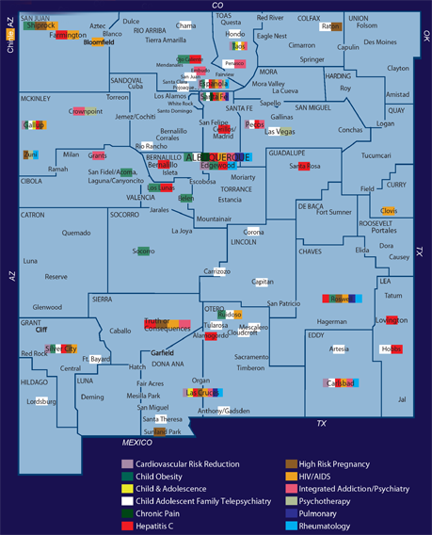
Community-Based Research
Notes:
10

Slide 11
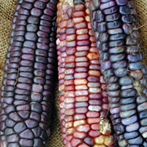
Vision & Goal: A center to research causes of and solutions to health disparities in NM. Funded by NIH, Center for Minority Health & Health Disparities, 2010-2015.

Slide 12
Aims/Goals
Expand research on health disparities interventions
Expand the number of researchers in health disparities interventions
Build community partnerships dedicated to research on health disparities and provide technical support
Eliminate health disparities in minority populations
Notes:
By expanding number of researchers we also aim to increase the number of community based researchers and are also hoping to increase minority faculty at UNM. Overall goal is to eliminate disparities.

Slide 13
Opportunity: NM CARES HD
Notes:
COMPONENTS
Administrative Core
Community Engagement Core
Research Core
Education and Training Core
Research project 1 - targeting serious adolescent mental and behavioral health, including suicide
Research project 2 - targeting screening and brief intervention for substance use disorders in primary care
__________________________________
Research project examining medical decision-making and cultural competency

Slide 14
Community Engagement Core
Goal - to access and build public trust and engage NM communities as equal partners in the conduct of research that informs effective health disparity interventions
Activities/Strategies -
Create partnerships between researchers and community constituencies for defining disparities research agenda
Assess barriers & facilitators to community engagement, and develop action strategies to enhance trust & partnership
Notes:
14

Slide 15
Community Engagement Core
Develop Intercultural Health Disparity Scholars and Summer Trainings
Translate & disseminate findings to enact practice, policy interventions, community capacity and programs
Utilize Community Liaisons to build linkages and bi-directional outreach and in-reach to identify Health Disparity research priorities
Work with the Community, Scientific Advisory Council (CSAC), Health Science Center (HSC) NM CARES HD leadership on strategic planning
Notes:
15

Slide 16
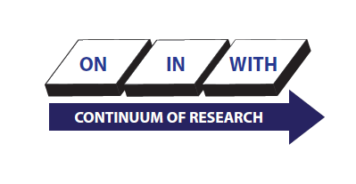
Community Scientific Advisory Council
Outreached & recruited CSAC members
Organized & facilitated first CSAC Bi-annual Meeting and produced summary report with recommendations
Coordinate ongoing bi-annual meetings
Notes:
16

Slide 17
Community Scientific Advisory Council
Themes for Action
1. Coordinate Intra-Institutional Communications
2. Address the Institutional Practices that Discourage Support of the Institution by the Community
3. Make the Community an Equal Partner
4. Eliminate rather than manage Health Disparities
5. Identify Best Practices
6. Increase Minority Faculty
Notes:
17

