Slide 1
UNM Radiologic sciences/ program overview

Slide 2
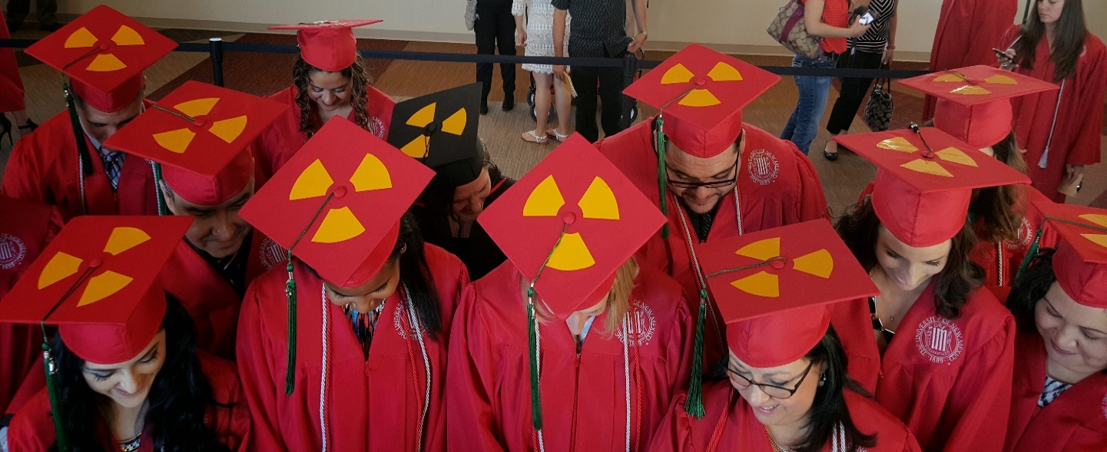
UNM Radiologic Sciences Program
Program Faculty
Rebecca Blankley: Radiologic Sciences Director/MRI
Elizabeth Greer: Principle Lecturer III
Lynnette Trujillo: Nuclear Medicine Program Director/Lecturer III
Kathy Roberts: CT Lecturer III
Alison Kleven: Nuclear Medicine Lecturer III

Slide 3
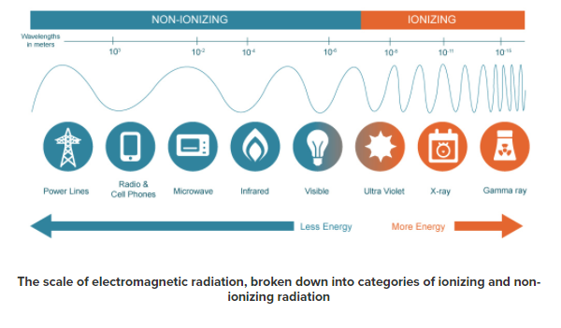
What is radiation?
Two types: Non-Ionizing Radiation and Ionizing Radiation
Ionizing radiation, which is caused by unstable atoms giving off energy to reach a more stable state, is more of a health threat to humans because it involves changing the basic makeup of atoms in cells, and more specifically the DNA molecules inside of cells.
Takes a very strong dose of radiation to substantially damage a cell’s structure, as there can be trillions of atoms in a single cell.
https://www.mirion.com/introduction-to-radiation-safety/what-is-radiation/

Slide 4
SOURCES OF RADIATION Terrestrial Radiation
Terrestrial radiation comes from radioactivity emitting from nuclides left over from when the earth was created.
Common radionuclides created during formation of earth:
Radioactive Potassium (K-40) found in bananas, throughout the human body, in plant fertilizer and anywhere else stable potassium exists.
Radioactive Rubidium (Rb-87) is found in brazil nuts among other things.

Slide 5
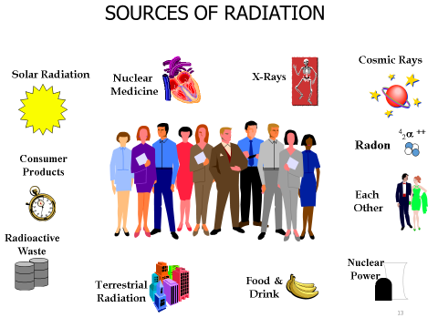

Slide 6
What Does a Radiologic Technologist Do?
Radiologic Technologists operate diagnostic machines in designated clinical areas of a hospital, medical center, diagnostic imaging center or physician’s office in order to provide images for medical diagnosis and/or treatment of disease.
Practice AIDET (Acknowledge, Introduce, Duration, Explain, Thank You) communication with EVERY patient!
https://www.bing.com/videos/search?q=aidet&&view=detail&mid=32BA5627E89919D08FEC32BA5627E89919D08FEC&&FORM=VDRVRV
(4 minute video)

Slide 7
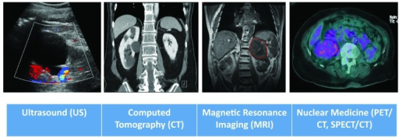
Diagnostic Imaging Is?
X-ray
CT
MRI
Nuclear Medicine
Ultrasound
Radiation Therapy

Slide 8
Where are the Various Medical Imaging Programs
Radiography (Primary)
CNM, PIMA, DACC, Clovis CC
Sonography/Ultrasound (Primary)
CNM, DACC
Radiation Therapy (Primary)
Out of State
Nuclear Medicine (Primary)
UNM
MRI (Post Primary)
UNM
CT (Post Primary)
UNM
*In order to obtain a post primary certification you must first
complete a primary certification.

Slide 9
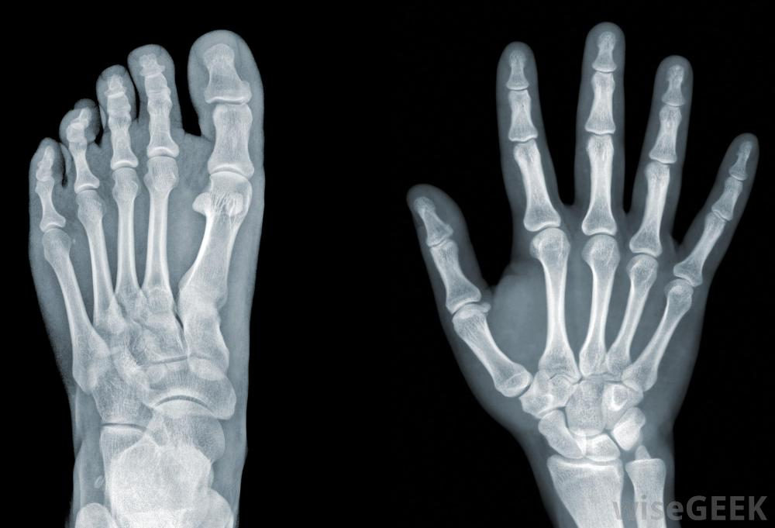
What is an X-Ray/General Radiography?
A photographic or digital image of the internal composition of something, especially a part of the body, produced by X-rays being passed through it and being absorbed to different degrees by different materials

Slide 10
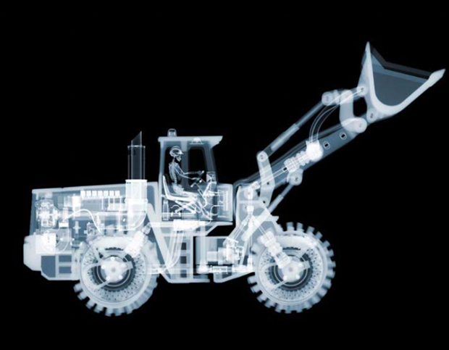
X-Ray of
front-end
loader with Skeleton
London Artist Nick Veasey- Using an
industrial X-Ray machine

Slide 11
X-Ray/Radiography in New Mexico
Primary Program
Locations
CNM, PIMA, DACC, Clovis CC
Salary
Radiologic Technologists:
$58,440 (CNBC Report 2019)

Slide 12
What is an Ultrasound (Sonography)?
Ultrasound imaging (sonography) uses high-frequency sound waves to view inside the body.

Slide 13
Ultrasound Then and Now

Slide 14
Sonography/Ultrasound in New Mexico
Primary Program
Locations
CNM, DACC
Salary
Sonographers
$71, 410 (CNBC Report 2019)

Slide 15
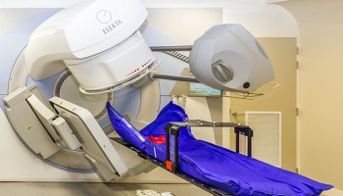
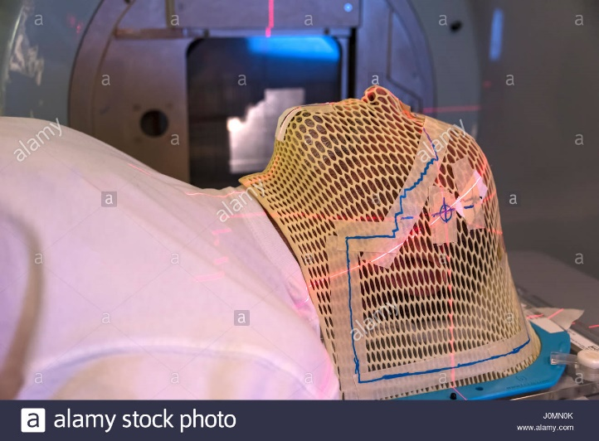
What is an Radiation Therapy?
The treatment of disease, especially cancer, using X-rays or similar forms of radiation.
The use of radiation beams to kill cancer cells
Cast/Mold done to target area of interest

Slide 16
Radiation Therapy
Primary Program
Locations
Out of State
Post Primary Program
Locations
Weber State University online (Ogden, UT)
https://www.weber.edu/RadSci/radiationtherapy.html
Washburn University online (Topeka, KS)
http://www.washburn.edu/academics/college-schools/applied-studies/departments/allied-health/xt/index.html
Salary
Radiation Therapist
$80,570 (CNBC Report 2019)

Slide 17
Radiation Therapy vs. Chemotherapy
Radiation therapy uses highly advanced technology to deliver targeted beams of radiation to kill cancer cells.
Targets only the areas of the body affected by the cancer leaving the healthy cells alone or able to repair.
Chemotherapy utilizes special drugs that are designed to target and kills cells that divide rapidly throughout the entire body.
Chemotherapy drugs work through your whole body, not just a specific part, so they can more effectively prevent the cancer cells from spreading to other parts of the body.

Slide 18
What is Nuclear Medicine?
The branch of medicine that deals with the use of radioactive substances in research, diagnosis, and treatment
Function studies
Nuclear Medicine (SPECT/CT) - https://www.youtube.com/watch?v=qSTt-Ccx1ak
(2 minute video)
Whole Body Bone Scan

Slide 19
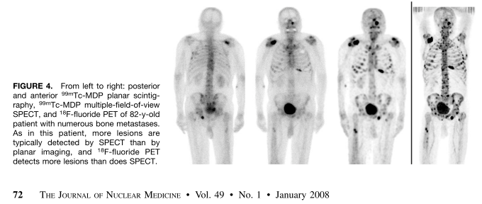
Nuclear Medicine Bone Scan vs. PET Scan
Tc99m MDP Bone Scan
F18-FDG PET Scan
PET imaging more sensitive to finding metastatic lesions

Slide 20
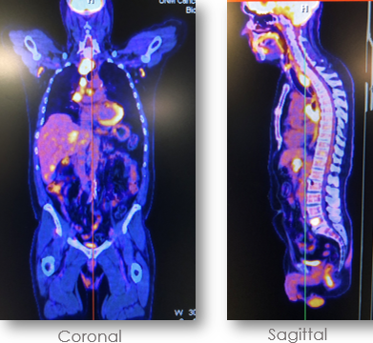
PET/CT Melanoma (Rt. Thigh)
PET/CT Small Cell Lung CA
GI Bleed
*Note: Melanoma and GI are media files

Slide 21
Nuclear Medicine Renogram Exam
Renogram is a study of the kidney’s. It examines the kidneys and assess the function. Looking for obstructions.
https://www.youtube.com/watch?v=jMNDvihVwvM
(13 second video)

Slide 22
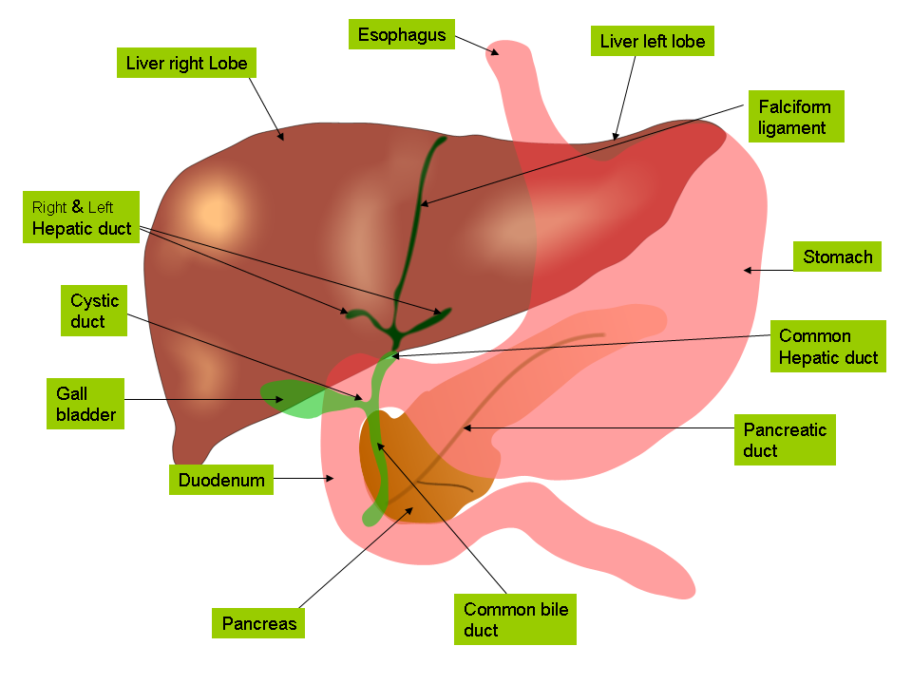
Nuclear Medicine Hepatobiliary (HIDA) Exam
Hepatobiliary (HIDA) Scan for a bile leak
*Note: Media file

Slide 23
Nuclear Medicine in New Mexico
Primary Program
Locations
UNM
Salary
Nuclear Medicine Technologists
$75, 660 (CNBC Report 2019)
Nuclear Medicine Career
https://www.youtube.com/watch?v=XcaChXkQmbM
(4 minute video)

Slide 24
What is CT?
A computed tomography (CT) scan uses X-rays to make detailed pictures of structures inside of the body
https://www.bing.com/videos/search?q=YouTube+CT+Scan&&view=detail&mid=B9257483315DADE32854B9257483315DADE32854&rvsmid=AE88A8539B01F6E7C05FAE88A8539B01F6E7C05F&FORM=VDQVAP
(3 min video)
Liver
Kidney (Right or Left?)

Slide 25
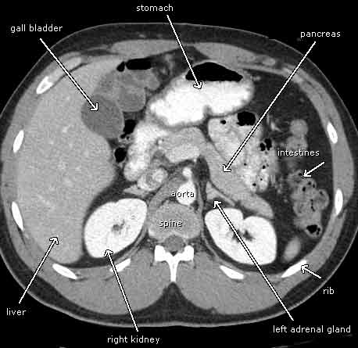
CT of the Abdomen
http://www.gereports.com/post/107344100845/new-ct-scan-can-see-bones-and-organs-in-stunning

Slide 26
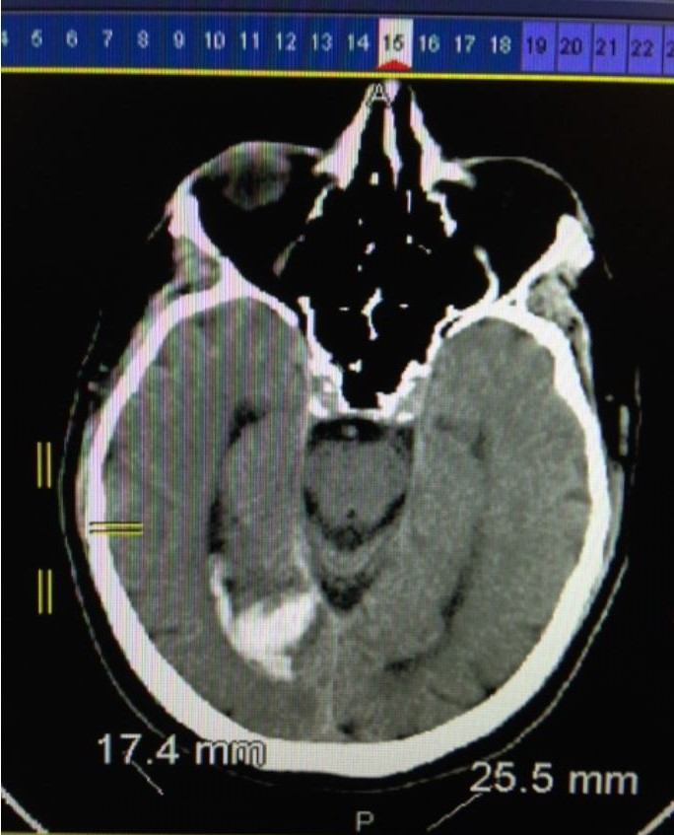
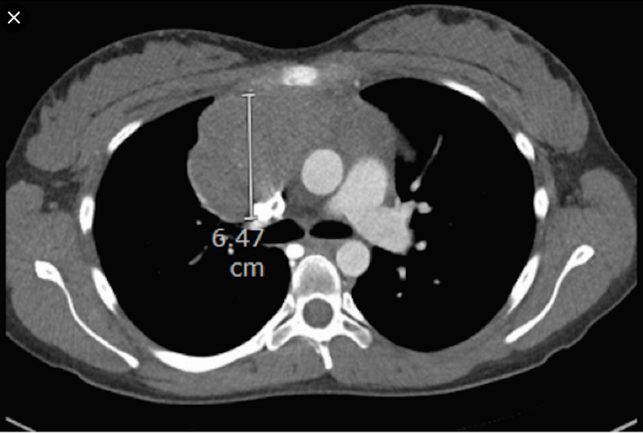
CT IMAGES
Brain Bleed
http://www.gereports.com/post/107344100845/new-ct-scan-can-see-bones-and-organs-in-stunning
Lymphoma

Slide 27
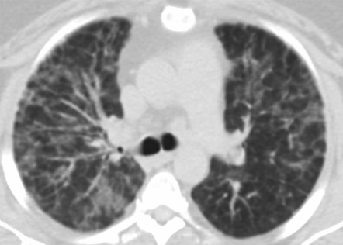
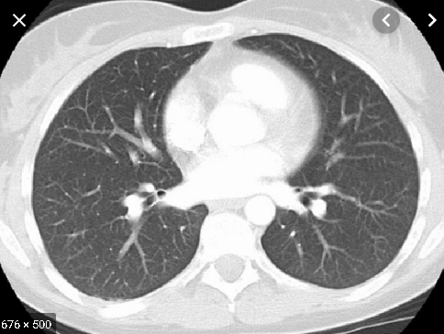
Vaping-associated Lung Injury. Demonstrating Giant
Cell Interstitial Pneumonia
Vaping Lung CT Scan
Normal Lung CT Scan

Slide 28
Computed Tomography (CT) in New Mexico
Post-Primary Program
Locations
UNM
Salary
CT Technologists
$56,972 (2016)

Slide 29
What is an MRI ?
Magnetic resonance imaging (MRI) is a test that uses a magnetic field and pulses of radio wave energy to make pictures of organs and structures inside the body
https://www.bing.com/videos/search?q=Different+Radiology+Careers&&view=detail&mid=51B8ACC72566B83F626151B8ACC72566B83F6261&&FORM=VDRVRV
(7 minute video)
Lower Spine

Slide 30
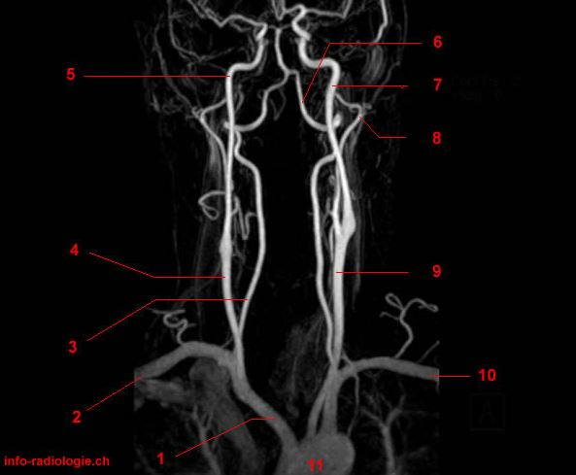
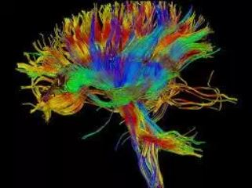
MRI IMAGES
MRI Diffusion Tensor Imaging (DTI) Pulse Sequence
showing White Matter Tracts Connecting Brain regions.
Magnetic Resonance Angiography (MRA)
showing carotids- using no IV contrast

Slide 31
Dangers of MRI
https://www.youtube.com/watch?v=plvIEf7JsKo
(2 minute video)

Slide 32
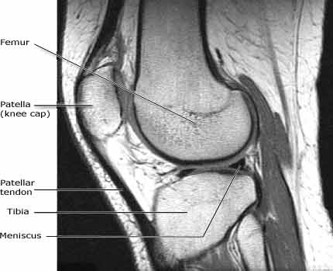
MRI of a Knee

Slide 33
Magnetic Resonance Imaging (MRI) in New Mexico
Post-Primary Program
Locations
UNM
Salary
MRI Technologists:
$ 69,930 (CNBC Report 2019)

Slide 34
Where will I work as a technologist?
Hospitals
Physician offices
Medical and diagnostic laboratories
Diagnostic imaging centers
Outpatient care centers
Perform research
Teacher or instructor
Bureau of Labor Statistics

Slide 35
What are the hours of work?
Medical Imaging Technologists usually work a 40-hour week, sometimes including evening, weekend or on-call hours.
Opportunities are also available for part-time and shift work, as well as flexible scheduling.

Slide 36
Where do I start to become an imaging technologist?
Start with your entry level courses
Can take at community colleges and universities around the state as well as at UNM.
Meet with the department for advisement/transcript evaluation to learn how to apply to a primary imaging program
UNM: Nuclear Medicine program
CNM & DACC(NMSU): Ultrasound (Sonography Program)
CNM, PIMA, Clovis CC, DACC: X-ray (Radiography Program)
Radiation Therapy may be offered at UNM CA Center through Weber State University online (Ogden, UT)
Good Grades important. Especially in Math and Sciences

Slide 37
Coursework and Clinical Overview at UNM to complete a BSRS &/or Certificate
Each program involves academic and clinical coursework to be completed at UNM.
Transfer in coursework from other schools normally your first two years or more are completed towards the BSRS.
Nuclear Medicine, CT and MRI
Course work with intensive clinical training at various medical facilities throughout the county/state.

Slide 38
Are you Empathetic?
Empathy vs. Sympathy
https://www.youtube.com/watch?v=1Evwgu369Jw
(3 minute video)
Extra Empathy Video
https://www.youtube.com/watch?v=cDDWvj_q-o8&feature=youtu.be
(4 minute video)
Notes:
Questions to ask audience for goodie bag
Name all the modalities under Radiology? Slide 6
X-ray
CT
MRI
Nuclear Medicine
Ultrasound
Radiation Therapy
Name the modalities that offer primary programs in New Mexico? Slide 7
Radiography (Primary)
CNM, PIMA, DACC, Clovis CC, ENMU-Roswell
Sonography/Ultrasound (Primary)
CNM, DACC
Radiation Therapy (Primary)
Out of State
Nuclear Medicine (Primary)

Slide 39
Contact Information for Program
University of New Mexico
School of Medicine
Radiologic Sciences Program
Email: Radiologicsciences.unm.edu
505-272-5254
Stevee McIntyre, B.A. Program Coordinator
stmcintyre@unm.edu

