Slide 1
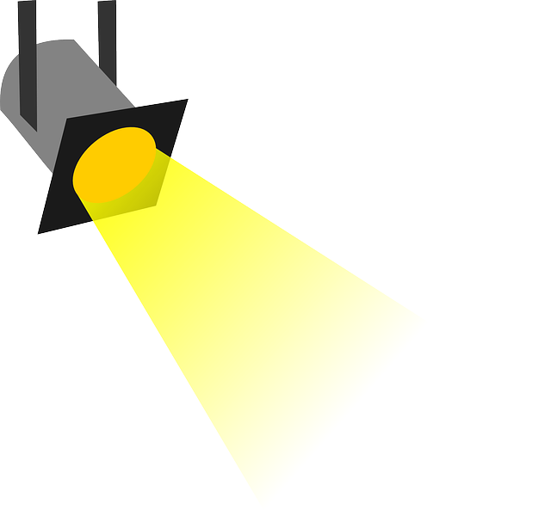
Understanding Endowed and Non-Endowed Spending Indices
Presented by
Cynthia Allison
Accountant III, HSC Unrestricted Accounting
October 9, 2019
Notes:
Good morning. Welcome to you all. My name is Cynthia Allison. I am one of the staff accountants in HSC Unrestricted Accounting. To be sure that you are where you intend to be, this is a LEARN session about Endowed and Non-Endowed Funds and Spending Indices. Also, if you haven’t taken a moment to jot down what you hope to find out in the session on the index card provided at the sign-in table, please do so now. If you need a card one of my colleagues will bring one to you. In fact, let me introduce them to you.

Slide 2
Presentation Goals
After this presentation you will be able to:
State the difference between endowed and non- endowed gifts
Explain the difference between gifts and contracts or grants
Find your Endowed Spending indices with MyReports
Find your Non-Endowed Spending indices with MyReports
Use Foundation Reports to identify Endowed Spending indices.
Notes:
Read text only. Sometimes there is confusion concerning these indices. We’re going to discuss how they are different from other indices and what that means for the operations of your unit or department.

Slide 3
What makes Foundation funds different from most UNM funds?
Sources of most UNM funding:
Source of endowed and
non-endowed funding:
State appropriations
Clinical revenue
Tuition revenue
Contracts & Grants
Gifts to the University
Notes:
Endowed and non-endowed spending indices belong to endowed and non-endowed funds. We can refer to them generally as Foundation funds. Foundation funds are located in HSC Research, Education, and Clinical Funds. What makes these funds different from most UNM funds?
Audience participation.
Even though gifts or donations are not as big a funding source as the others, UNM likes them – so much in fact, that there is a gift policy.

Slide 4
Policy 1030 – Gifts to the University
UNM seeks and values private philanthropy that supports it mission and helps it to:
Support, maintain, and grow its dynamic faculty
Recruit and retain talented students
Support and enrich its libraries, museums, and research capacity.
Notes:
Go over slide. Maybe ask what is UNM’s mission?

Slide 5
Gifts may not be designated for a specific individual but can be designated for UNM, a school or college, a department or a type of research or programming.
Notes:
WARNING! Read slide.
This means, for example, that a donation cannot be made for Dr. Allison to do research or for a scholarship for a specific student.. Gifts can however support a specific type of research or scholarships.

Slide 6
The UNM Foundation
The UNM Foundation was chartered in 1979 to solicit, accept, and manage private contributions.
It is a separate entity from UNM and is a 501(c)3 organization.
Gifts processed through the Foundation are considered a tax deductible charitable donation by the IRS.
Receipts for donations, which are required by the IRS, are issued to donors by the Foundation.
Notes:
Since gifts are important to UNM, deliver the text.

Slide 7
Gifts of All Types should be deposited with the Foundation!
Notes:
Therefore it makes sense that …. . Cash and checks should not be put on a UNM money list and taken to the bursar’s office. The Foundation has a transmittal form, which is like a deposit slip, to use with cash and check donations. In-kind gifts, such as equipment or gift cards or some donated service, must be reported to the Foundation on an In-kind donation form. Monica Peck from the Foundation graciously put together a reference sheet for you that has instructions for navigating these transactions. We’ll be handing it out as you leave. But for now, the important thing to know is that all donations must go through the Foundation.

Slide 8
Policy 1040
Fundraising by units of the University should be coordinated with the UNM Foundation and the unit’s development officer (when applicable).
All literature (newsletters, brochures, booklets) must be approved by the UNM Foundation.
Fundraising
Notes:
Finally, policy 1040 requires that all fundraising efforts by units of UNM must be coordinated with the Foundation and applicable development officer. This includes any literature created to solicit donations;

Slide 9
Gifts vs Grants
Grants/Contracts
Gifts
Require the return of money at the end of grant period
Require reports
Go through Sponsored Projects
No return of money
No reporting requirements
Go through the Foundation
If in doubt, call or email Sponsored Projects for advice.
Notes:
Other important information to know is the difference between gifts and grants/contracts. This is particularly true when a unit wants to set up a Foundation fund to receive donations. Sometimes what appears to be a gift is actually a grant. Go through the slide. Note: the amount of money has no bearing on how a “gift” is categorized. Things can become cloudy iwhen the money is coming from a foundation, small business or corporation. It’s important to thoroughly research the funding entity for any requirements attached to the monies being given. Some foundations, businesses and corporations actually do make donations but they also provide funds through a grant process.
Read If in doubt….

Slide 10
How is the $ handled?
Contract & Grants
You receive a check for $27.82 in the mail. A letter accompanies the check. The letter includes: “final payment: YYB764.”
You receive a check of $50,000 in the mail. A handwritten letter accompanies the check. In the letter it says, “My recently deceased husband was tenderly cared for at your hospital, and asked me to send some money to you in appreciation for all the hospital did to make him comfortable in his last days. Please use this money to make other patients comfortable.”
Foundation
Contract & Grants
You receive a check for $21,000 in the mail. A letter accompanies the check. The letter includes: “Clinical trial payment for Dr. Smith’s research on Fosimilox progression.”
Additional Research
You receive a letter (no check) saying “This is to notify Dr. Smith, we will be sending $42,000 next week.”
Notes:
Now we’ll consider a few examples and decide what type of fund the check represents and what should be done with it.

Slide 11
What are the two types of funds?
Endowed funds are large gifts that are invested and the income from these gifts is available for spending in an endowed spending index. Another index contains the actual gift (corpus). Monies in the corpus index are not available for spending.
Non-Endowed funds are gifts that are to be spent in their entirety and are posted in a non-endowed index.
Notes:
Foundation funds include two types.
Read text.
Let’s look at examples of how money flows to UNM with each type.

Slide 12
Donor gives $50,000 to establish an Endowment for lung cancer research
UNM Foundation deposits $50,000 in endowed fund and invests
UNM Foundation posts earnings from investment to account code 1011 or 12P0 in endowed spending index*
*Postings from the Foundation occur quarterly..
Notes:
Dr. John wants to give $50,000 for lung cancer research. He wants his gift to provide money into perpetuity – meaning not be sent itself. So…

Slide 13
Donor gives $50,000 to be spent in its entirety for lung cancer research
UNM Foundation deposits $50,000 to Non-Endowed Fund for lung cancer research
UNM Foundation posts $50,000 to account code 1000 in appropriate non-endowed index*
* Only the UNM Foundation may use account code 1000.
Notes:
Dr. Sylvia wants to give $50,000 to UNMHSC for lung cancer research and wants it to be fully spent on the research. So…

Slide 14
HSC Endowed & Non-Endowed Funds
Type | Fund Number | Name
Endowed | 3U0003 | HU Endowed Spending Education
Endowed | 3U0081 | HU Endowed Spending Research
Endowed | 3U0302 | HU Endowed Spending Clinical Svc
Non Endowed | 3U0002 | HU Non Endowed Spending Education
Non Endowed | 3U0001 | HU Non Endowed Spending Research
Non Endowed | 3U0301 | HU Non Endowed Spending Clinical Svc
Notes:
The HSC has three endowed funds and three non-endowed. If you look at the names of the funds, you’ll see that they are in the HSC General Research Fund 3U2, General Education Fund 3U3, and Clinical Service fund 3U4.

Slide 15
How may endowed and non-endowed funds be spent?
Spending must comply with:
Donor Intent
UNM Policy
School/College
Policy
Department
Policy
Notes:
Now we know how revenue arrives in a Foundation Fund and its related spending indices. How then do we go about spending the funds? Spending from Foundation funds must comply with: …..
Note: all UNM spending must comply with the institutional policies referred to above. Donor Intent is the added filter.

Slide 16
Donor Intent
Donor intent specifies how the donor wants the funds to be spent.
Donor intent can be found on the Fund Establishment Form.
Remember, monies spent must also comply with UNM, school/college, and department policies.
Notes:
Read first bullet. It essentially tells us why the donor is giving the funds. Any spending from a Foundation fund must comply with donor intent. Whenever, you are considering spending, this is the first requirement that must be met.
Read second bullet.
Read 3rd bullet.

Slide 17
Endowed Fund Establishment Forms
Fund Establishment Forms for endowed funds are stored at the UNM Foundation.
To receive information on donor intent, contact the UNM Foundation.
Notes:
Paraphrase text

Slide 18
Non-endowed Fund Establishment Forms
Fund Establishment Forms for non-endowed funds are stored in ApplicationXtender.
To access these forms, use Banner screen FTMACCI.
.
Notes:
Read text.

Slide 19
FTMACCI
Notes:
Animation: U, 914985 Retrieve

Slide 20
Application XTender
Notes:
There are two documents in this index’s record. The sig auth form and “animation.”

Slide 21
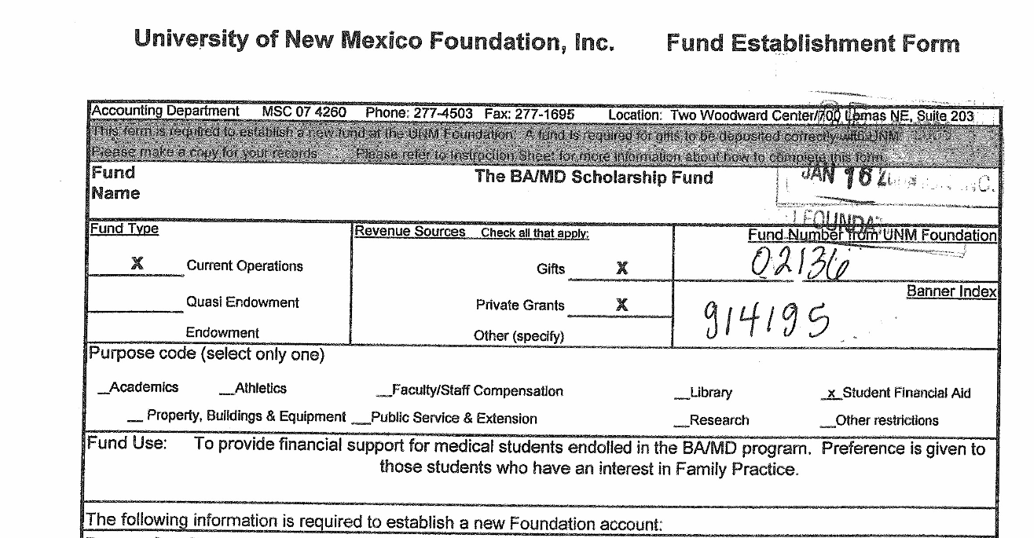
Notes:
Here is the upper part of the Fund Establishment form that contains donor intent. Animation
Read the intent.
This is very specific. So… couldn’t use for med students not in the BAMD program, residents, faculty. Probably not office supplies or food.
Some donor intent statements are more general. The most general in fact says a version of spending is “at the discretion of the department chair.” However, this does not mean money can be spent on things not allowed by institutional policies or that are extravagant. So… you really can’t fund a holiday part with these monies.

Slide 22
How to Find your Spending Indices
Run MyReports FORURBH for endowed funds 3U003, 3U0081, 3U0302 and non-endowed funds 3U0001, 3U0002, and 3U0301. The report will list all of your spending indices as well as the available balance in each. Note: This report is located in the F HSC Reports folder.
For endowed funds only, consult your department’s most recent Endowment Activity Report or Endowment Spending Distribution Report. The indices are listed on the report.
Notes:
Now that we’re covered the basics, let’s look at how to find the Foundation spending indices for a given department.
Paraphrase first bullet. Paraphrase second bullet.

Slide 23
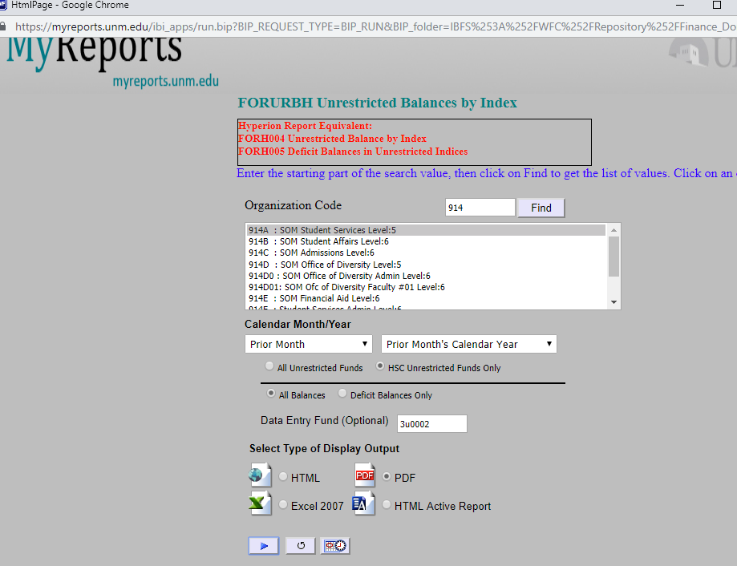
Notes:
We’ll run through an example of how to use FORURBH.

Slide 24
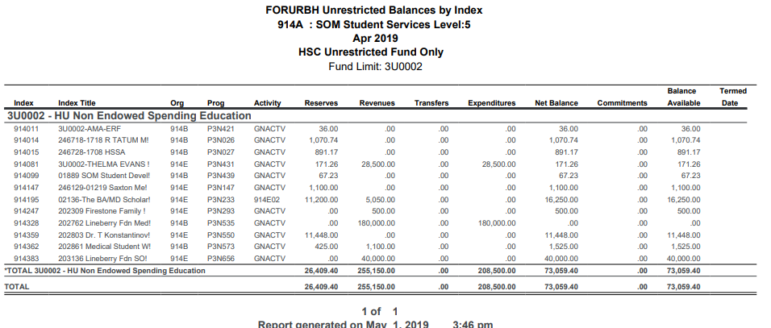
Notes:
Department and Fund are listed at the top of the report. Indices are on the left with corresponding balances on the right. The report also gives you totals for revenue and expenditures. Running this report is the best way to find your non-endowed indices.

Slide 25
Foundation Reports
Endowment Activity Report
Endowment Spending Distribution Report
Emailed to departments
Distributed quarterly (about 2 months after end of quarter)
Emailed to departments
Distributed annually (usually near the beginning of March.)
Notes:
While you can use FORURBH to find endowed spending indices, you can also use the Foundation Activity Report and the Endowment Spending Distribution Report.

Slide 26
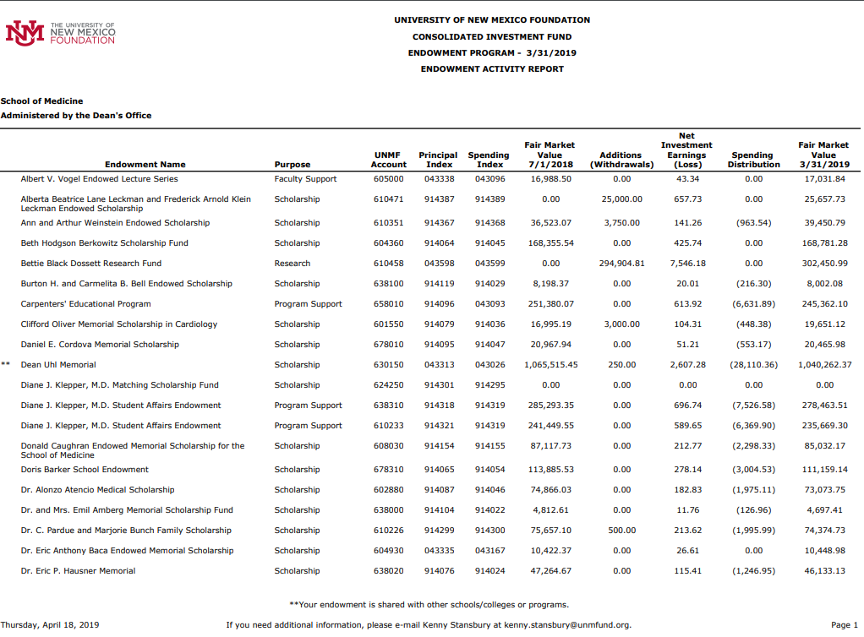
Endowment Activity Report
Notes:
Endowment Activity Report is sent to the departments quarterly. It shows your endowed spending indices and the amount of distribution that has occurred as of the date of the report.

Slide 27
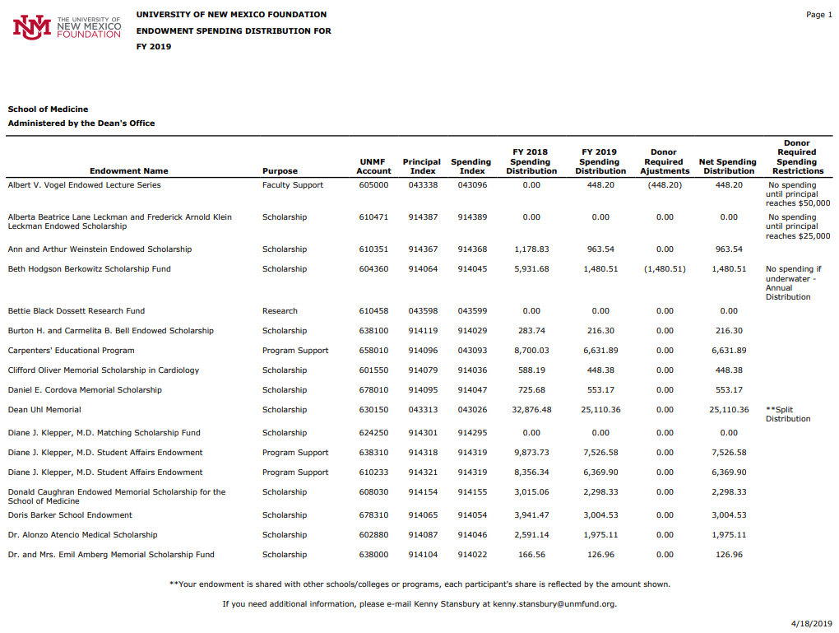
Endowment Spending Distribution Report
Notes:
The Endowment Spending Distribution Report is sent to the departments annually. It also show the endowed spending indices and the amount distributed to the various indices.

Slide 28
Other Useful Reports and Banner Screens
In MyReports, the FOROLDS report will show the detail, by index, of your endowed and non-endowed spending indices. This will include current balances in all revenue and expense accounts as well as the total balance available.
It is found in the F All Campus Reports folder in MyReports.
Notes:
There are other useful Reports and Banner screens to help you make decisions about spending in these indices.

Slide 29
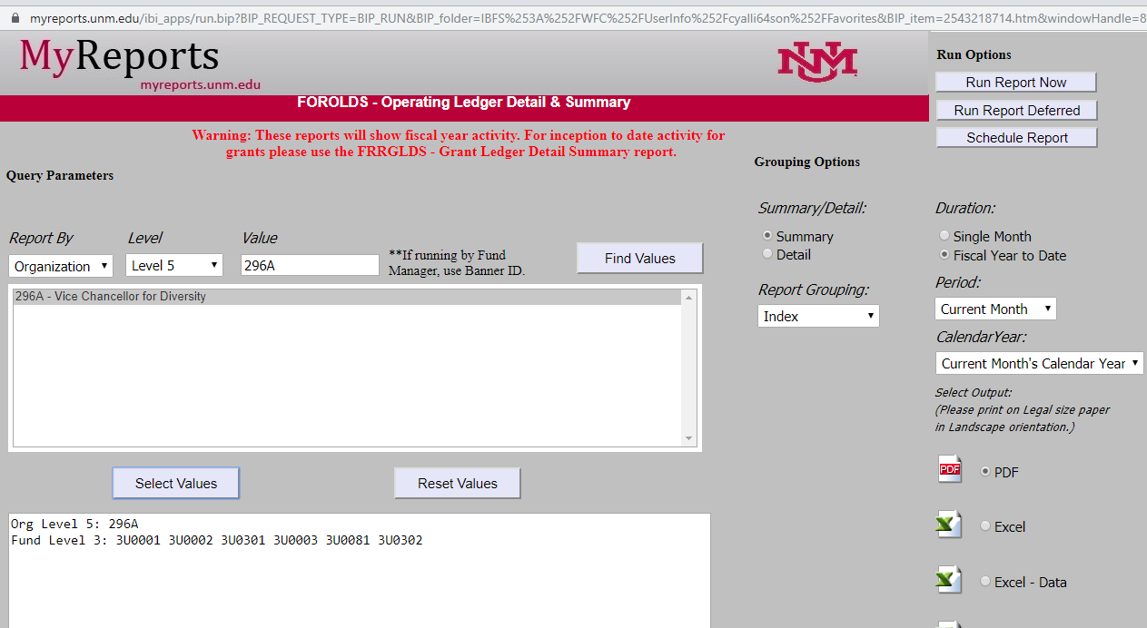
FOROLDS Report Criteria
Notes:
Enter your department’s org – usually a Level 5 but could be a 6 or 7.
All Level 3 Foundation funds have been chosen. You can of course do fewer.
Check “Detail”
Choose group by Index.

Slide 30
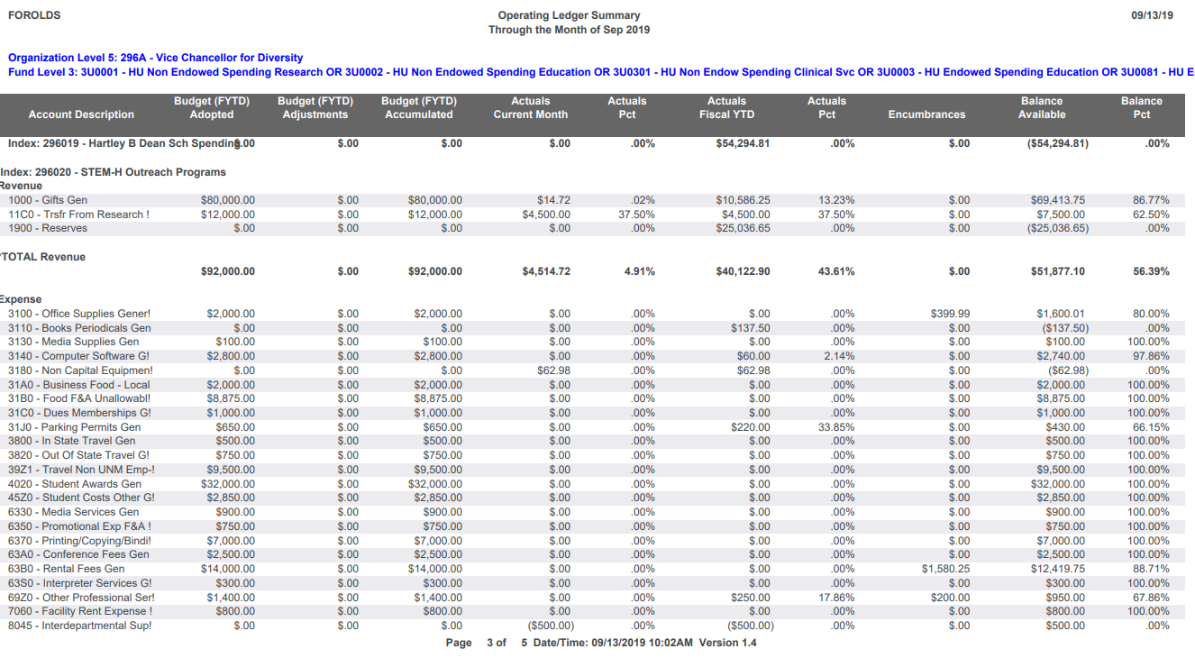
A Page from the FOROLDS Report
Notes:
Here is a page from the FOROLDS report that was run.
Index
Total Revenue
amount but also the revenue accounts that make up the total revenue are listed.
Total Expenses
Amount – and again the accounts that make up the total are listed.
Finally, there is the net balance given the actual revenues and spending.
You can see that the report also shows budget figures and balances available for spending in absolute numbers and percentages.
This is a very useful report.

Slide 31
Other Useful Reports and Banner Screens
Banner screen FGIBDST gives detailed information for a single index.
Drill down on accounts to see the transactions posted to any given account.
Notes:
You may want to investigate all the individual transactions that make up the balance in a given index.
Read text

Slide 32
FGIBDST - Viewing the Detail
Notes:
Enter the index and 1. click go.

Slide 33
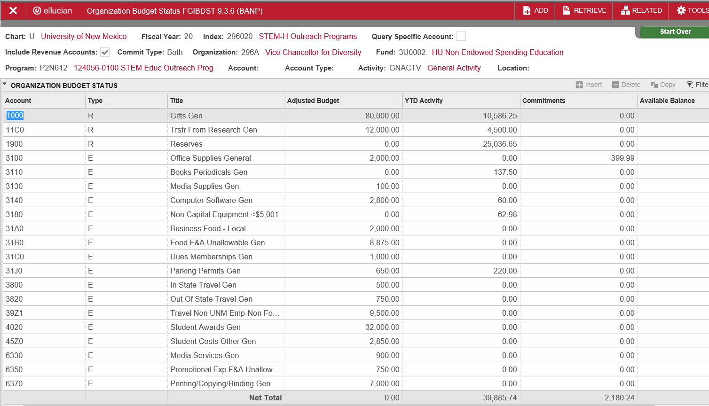
FGIBDST – Viewing the Detail
Notes:
This information is similar to what was in the FOROLDS report we looked at. It’s one day more current.
Please notice the revenue account is account code 1000 – Gifts. As of early September 2019, around $10,000 has actually been received. So… for 1/6 of the FY, 1/8 of the revenue has come in. We’ll discuss why noticing this is important in a bit.

Slide 34
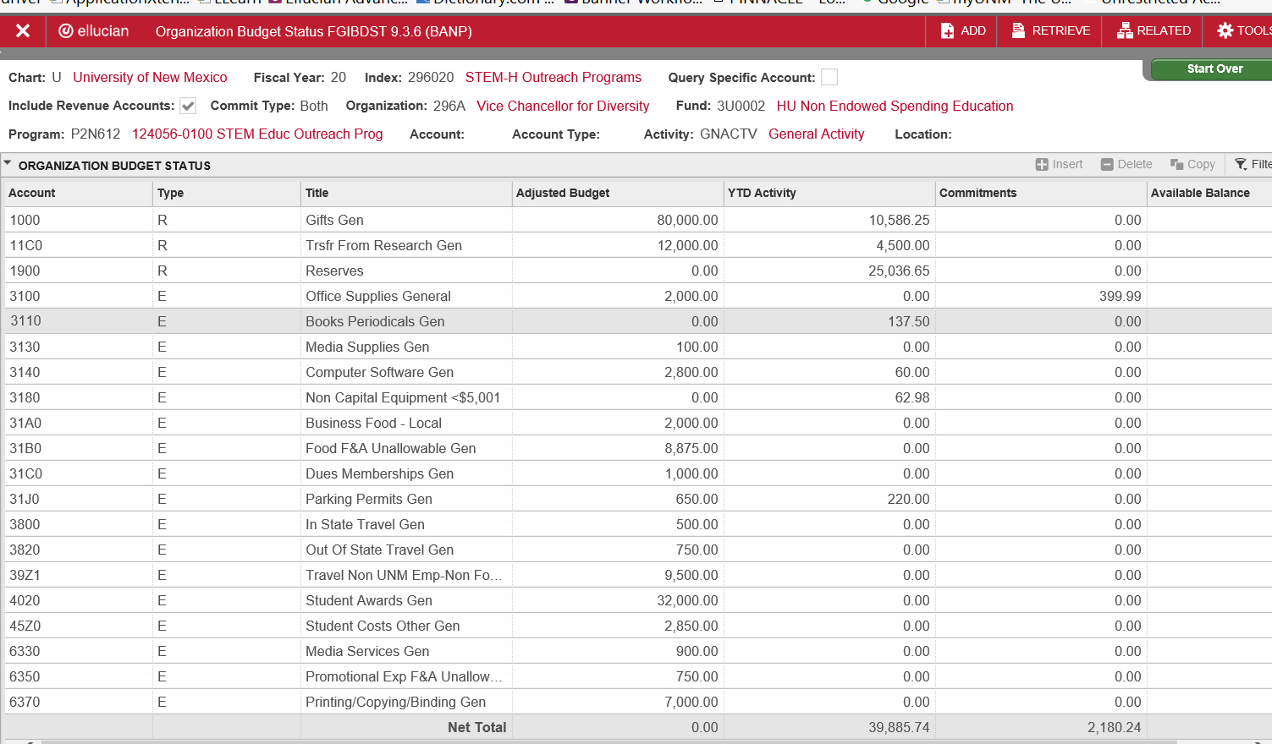
FGIBDST – Drilling Down
Select “Transaction Detail Information”
Notes:
If we want to see the individual transactions in a given account, like account 3110 in this example, we can “drill down” into the data.
The account we’re interested in, 3110, is highlighted.
Click Related
Select “Transaction Detail Information.”

Slide 35
FGIBDST – Drilling Down
Notes:
Once you see the specific transactions, you can continue to drill down to learn more.

Slide 36
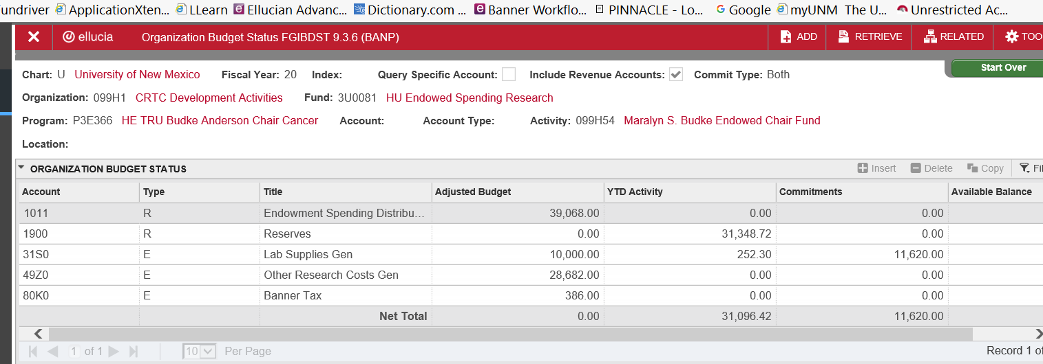
FGIBDST - Example of
Endowed Spending Index
Notes:
Finally, here is an example of the FGIBDST for an endowed spending index. Notice the revenue account
1011 – Endowed Spending Distribution. While there is no actual revenue posted, the department can expect about $39,000 in revenue by year’s end. Remember, the actual distributions are posted quarterly.

Slide 37
Budgeting Strategies
Like all other indexes, endowed and non-endowed indices should have a budget for each fiscal year.
Allowed expenses are determined by donor intent and other institutional policies.
Notes:
Our last topic for today concerns budgeting for foundation indices.
Read bullets.

Slide 38
Budgeting Strategies
Revenue projections for endowed spending indices are provided by the Foundation before budgets are due in the spring. These estimates are very reliable so it makes sense to budget spending up to that amount.
Notes:
Read slide.

Slide 39
Budgeting Strategies
Projecting revenue for non-endowed spending indices requires some thought and research since gift amounts are not predetermined as with endowed indices. Evaluating the gift history for previous years is a reasonable way to make these estimates. Additionally, conservative estimates protect against a deficit in the index.
Notes:
However, read text.

Slide 40
At year end, Foundation spending indices may not be in deficit.
CAUTION
To avoid
Spend according to your budget!

Slide 41
Notes:
Now, let’s use all of this information to consider a scenario.

Slide 42
On May 25, you’re given the following information:
Faculty member Wonder Woman is traveling to Africa on UNM business to attend a conference on improving strength in women over 60. Estimated cost: $9,490. You are to use your Pcard to prepay this expense.
You’re instructed to use either index ABCDEF or UVWXYZ.
You check donor intent for each index and the travel is an appropriate expense for either index.
Which index would you choose and why?
Do you need more detailed information to make your decision?

